Slide 1
Welcome to the Parliamentary Procedure workshop!!

Slide 2
What do you already know?
- What is parliamentary procedure?
- Why do you think we use parliamentary procedure?
- Where have you seen parliamentary procedure used before?

Slide 3
What is Parliamentary Procedure
The rules used to run a meeting

Slide 4
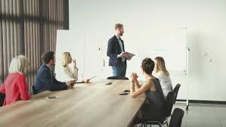
How to run a meeting:
What are some things you’ve seen done before at meetings?

Slide 5
Objectives of Parliamentary Procedure:
Focus...
Observe...
Extending...
Protecting...

Slide 6
Objectives of Parliamentary Procedure:
Focus on the task at hand
Observe...
Extending…
Protecting…

Slide 7
Objectives of Parliamentary Procedure:
Focus on the task at hand
Observe the rights of the majority
Extending…
Protecting…

Slide 8
Objectives of Parliamentary Procedure:
Focus on the task at hand
Observe the rights of the majority
Extending courtesy to all
Protecting…

Slide 9
Objectives of Parliamentary Procedure:
Focus on the task at hand
Observe the rights of the majority
Extending courtesy to all
Protecting the rights of the minority

Slide 10
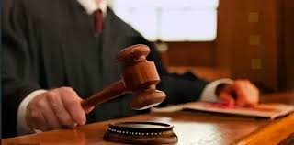
Gavel taps:
- What are the different types of gavel taps and what are each used for?

Slide 11
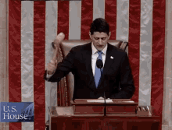
Gavel taps:
1 tap - Conclusion of business, adjourned the meeting, or to have people sit.
2 taps - Calls the meeting to order.
3 taps - Signal for all members to stand. Stand on the 3rd tap!!
Series of sharp taps - Regain order

Slide 12
Handling motions:
Most common:
Main motion - To introduce new business
Amendment - To make changes to a motion
Point of order - To call out a breach in parliamentary procedure.
Adjourn - To conclude and end the meeting

Slide 13
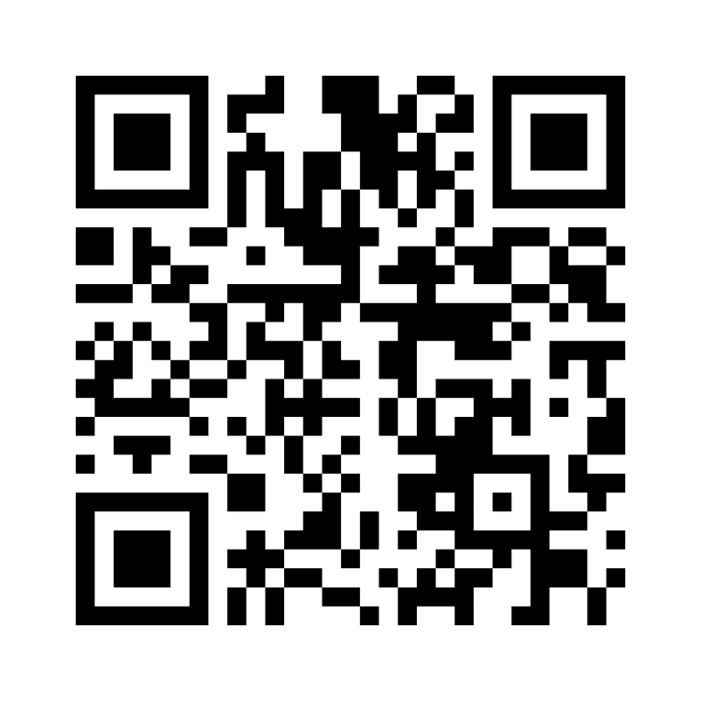
Please Participate

Slide 14
6 basic steps to handle motions:
Member makes the motion
The results of the vote are announced
Another Member Seconds the motion
Members discuss the motion
Chair holds a vote
Chair Says the motion
Notes:
Parliamentary Procedure Workshop Question - Mentimeter

Slide 15
6 basic steps to handle motions:
Member makes the motion
3. Another Member Seconds the motion
6. Chair Says the motion
4. Members discuss the motion
5. Chair holds a vote
2. The results of the vote are announced
Notes:
https://www.mentimeter.com/s/f69d261252afff024524b259f376e141/4780c7fc6e1b/edit

Slide 16
Thank you!
- Any questions???

