Slide 1
Z-Suite Homepage
Begin by searching, https://4h.zsuite.org/
Select “Sign-Up” and “Register New Household”

Slide 2
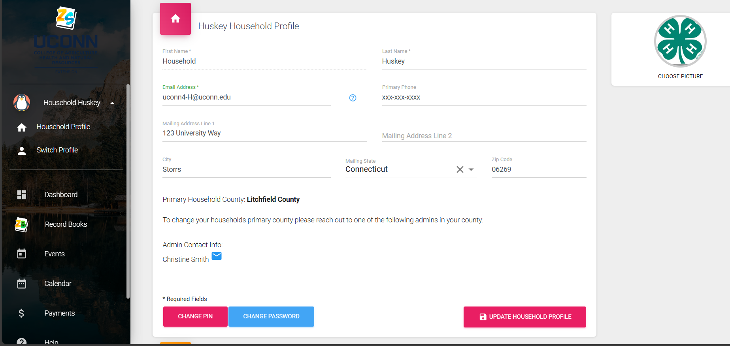
Z-Suite Household Information
Enter Household Information seen above

Slide 3
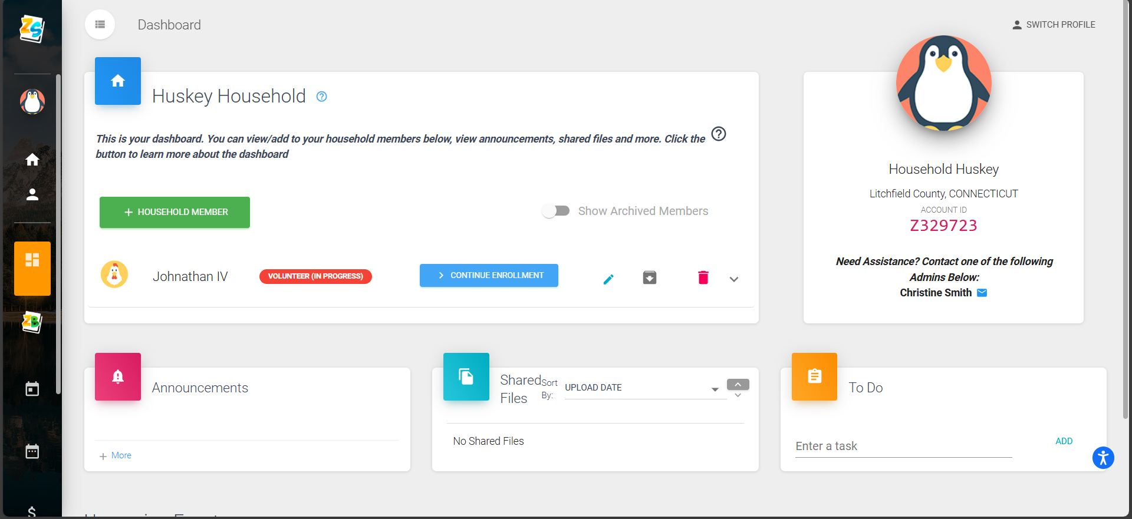
Z-Suite Household Members
Go to “Dashboard” Select “+ Household Member”
New Household members will appear below (see Jonathan IV profile)

Slide 4
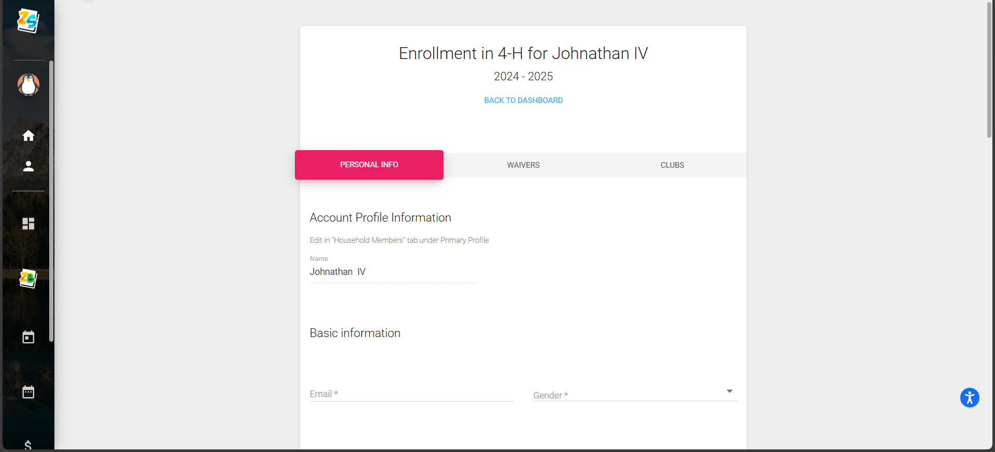
Member Enrollment
Enter Personal Information for the profile

Slide 5
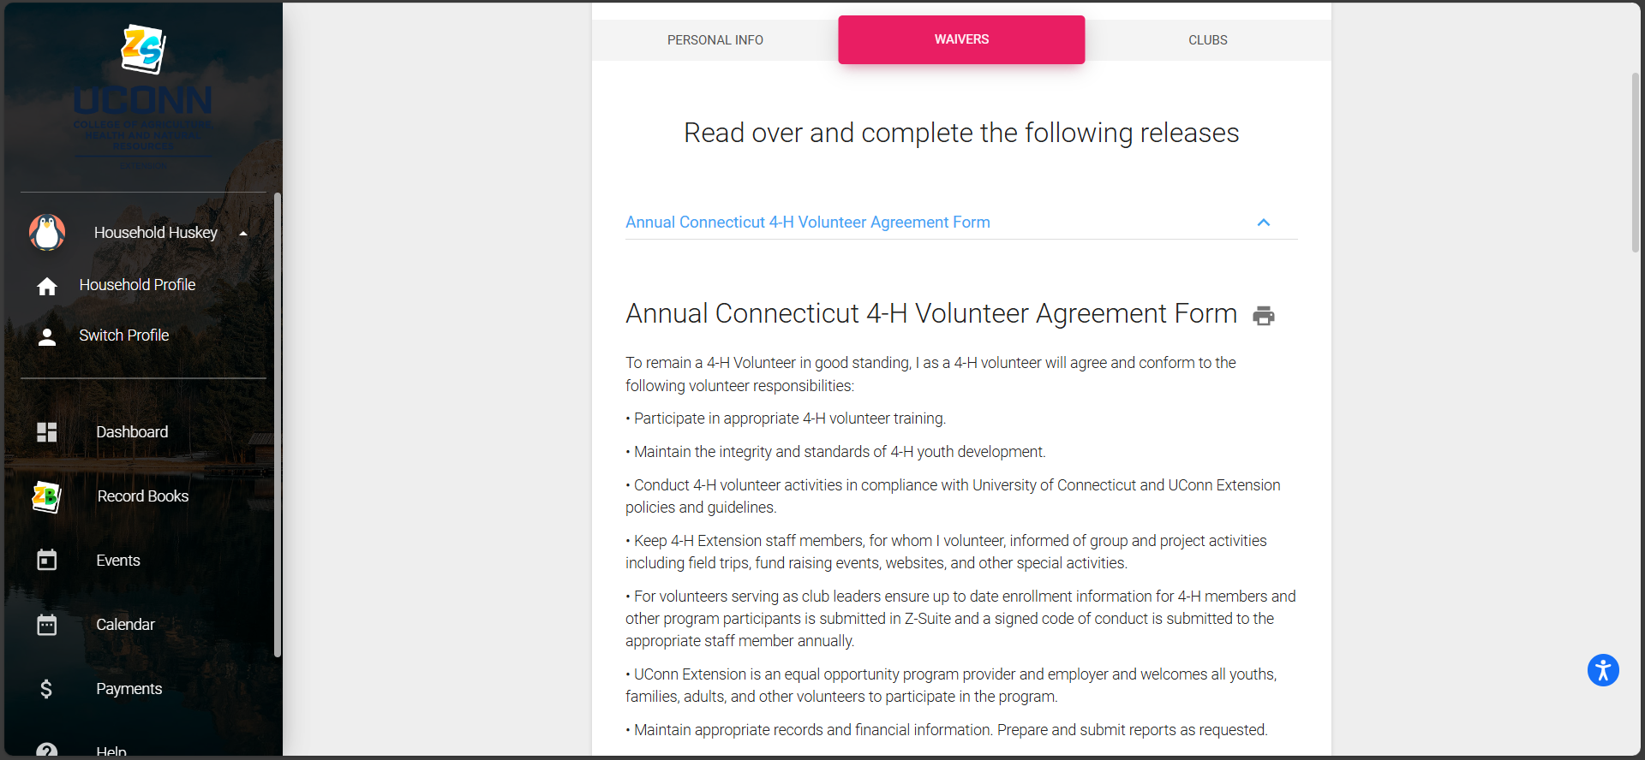
Annual Waivers
Complete the three waivers attached: Annual Connecticut 4-H Volunteer Agreement Form, 4-H Volunteer Application Form, UConn 4-H Volunteer Code of Conduct

Slide 6
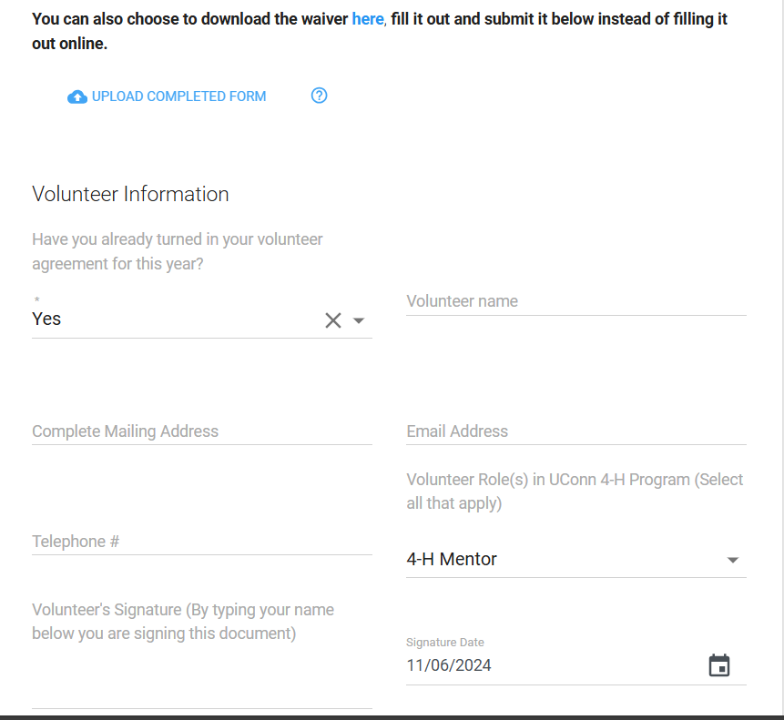
Annual Connecticut 4-H Volunteer Agreement Form
Complete the following fields: Name, Email, Mailing, Telephone, Role(s), signature and date

Slide 7
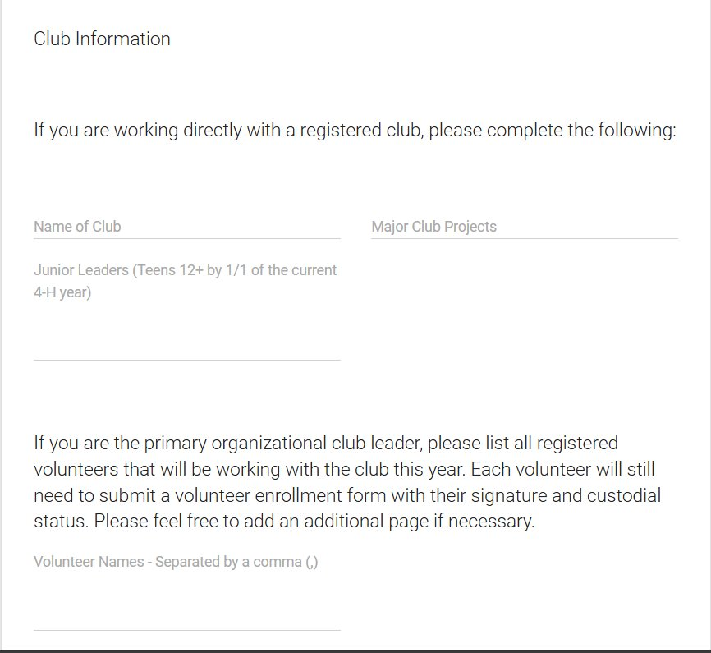
Annual Connecticut 4-H Volunteer Agreement Form Cont.
Complete the following fields: Club name, projects, Junior leaders and additional volunteers*
*Only if primary club leader

Slide 8
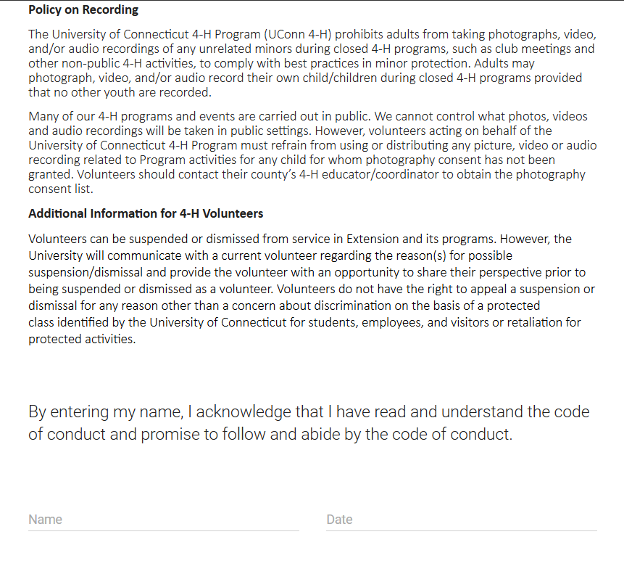
UConn 4-H Volunteer Code of Conduct

Slide 9
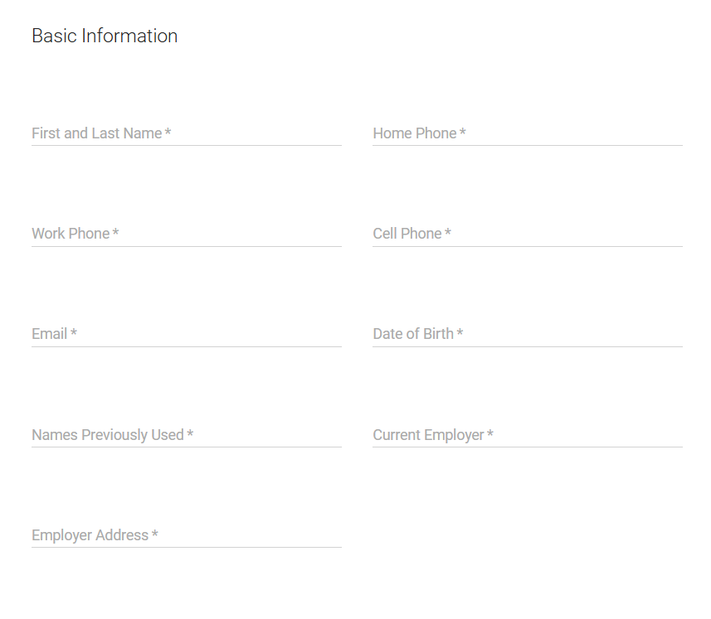
4-H Volunteer Application Form
Complete the following fields: Basic Information, Mailing Address, Skills and Interest, Additional Information and signature

Slide 10
Z-Suite Household
Once your enrollment is complete the “In Progress” will change to “Pending Approval”

Slide 11
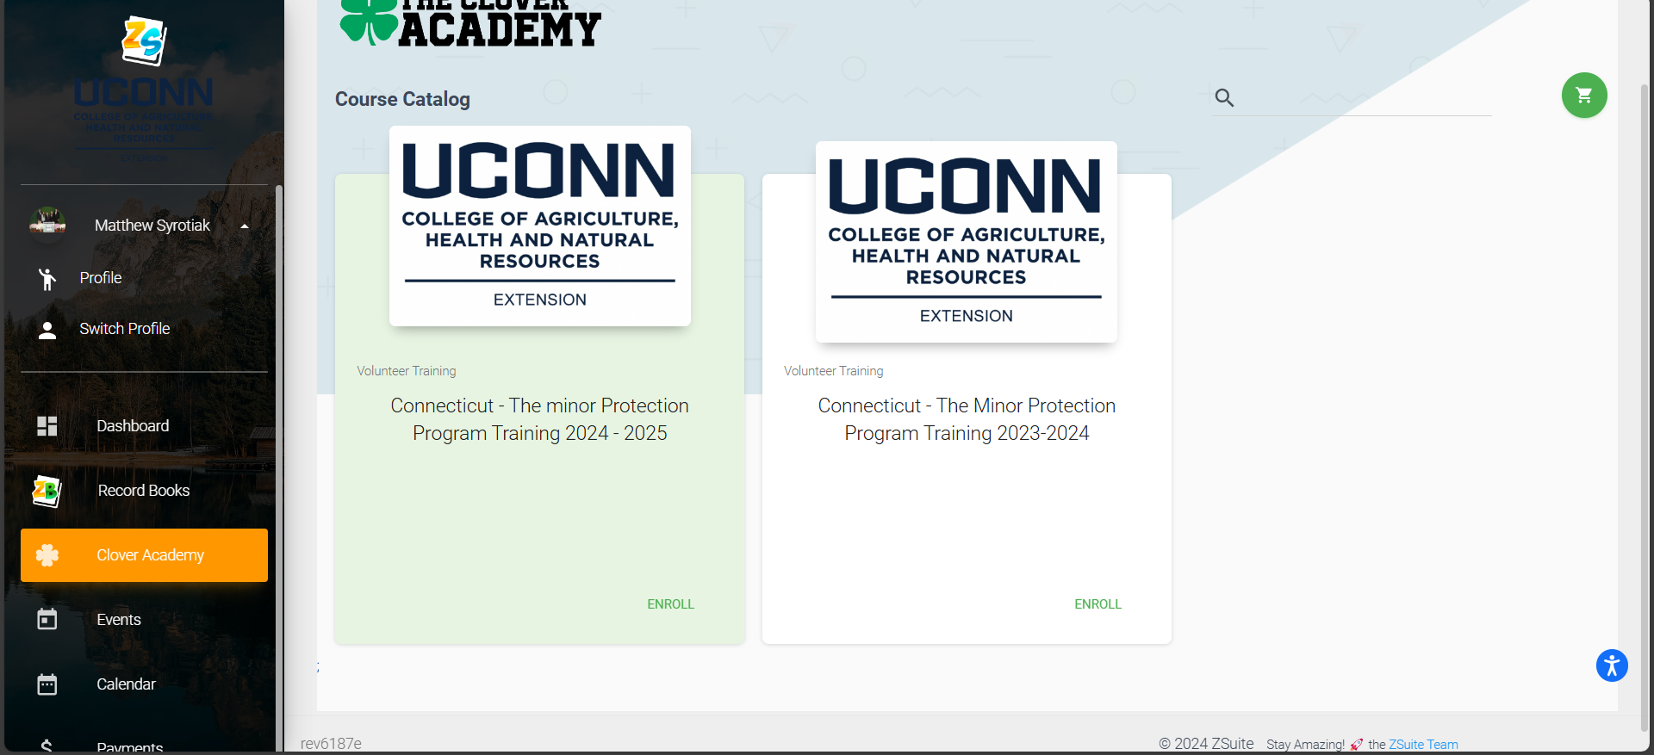
Minor Protection Training
Select the "Clover Academy" tab, Enroll in the Minor Protection Training for the current year and complete all modules. Note you must be in your individual profile NOT household.

