Slide 1
Z-Suite Homepage
Begin by searching, https://4h.zsuite.org/
Select “Sign-Up” and “Register New Household”

Slide 2
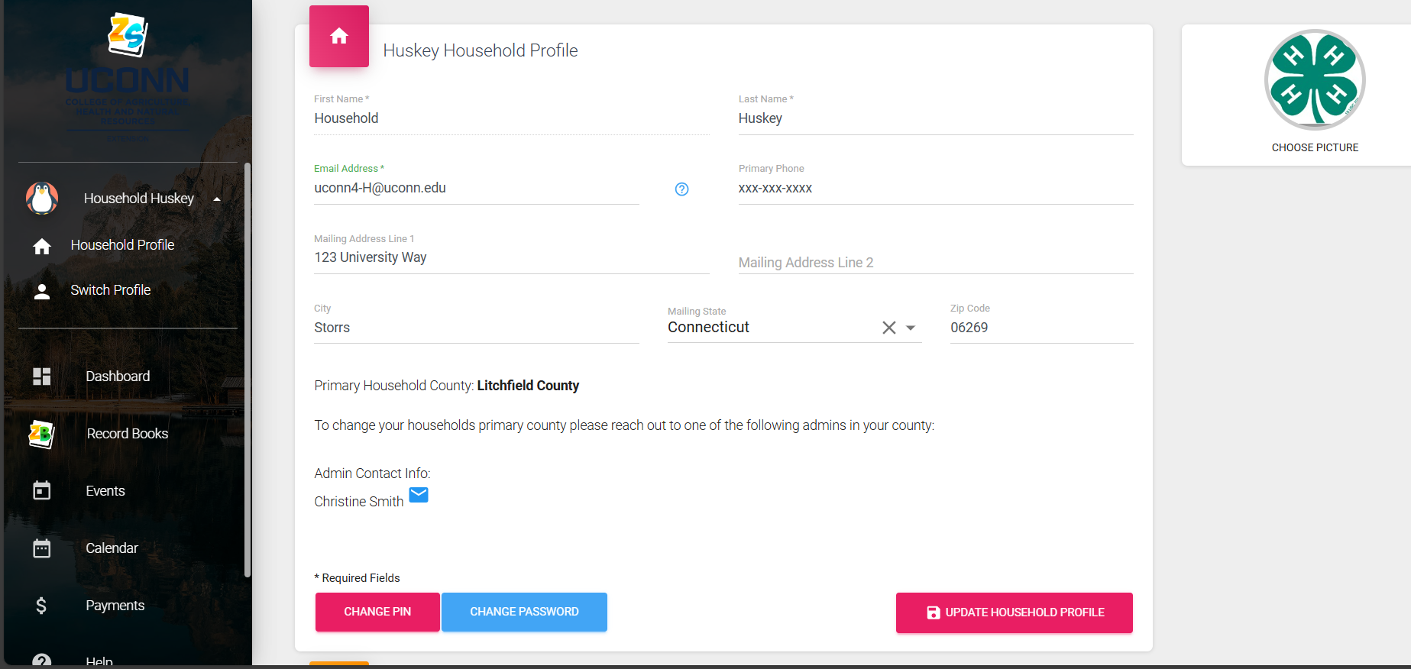
Z-Suite Household Information
Enter Household Information seen above

Slide 3
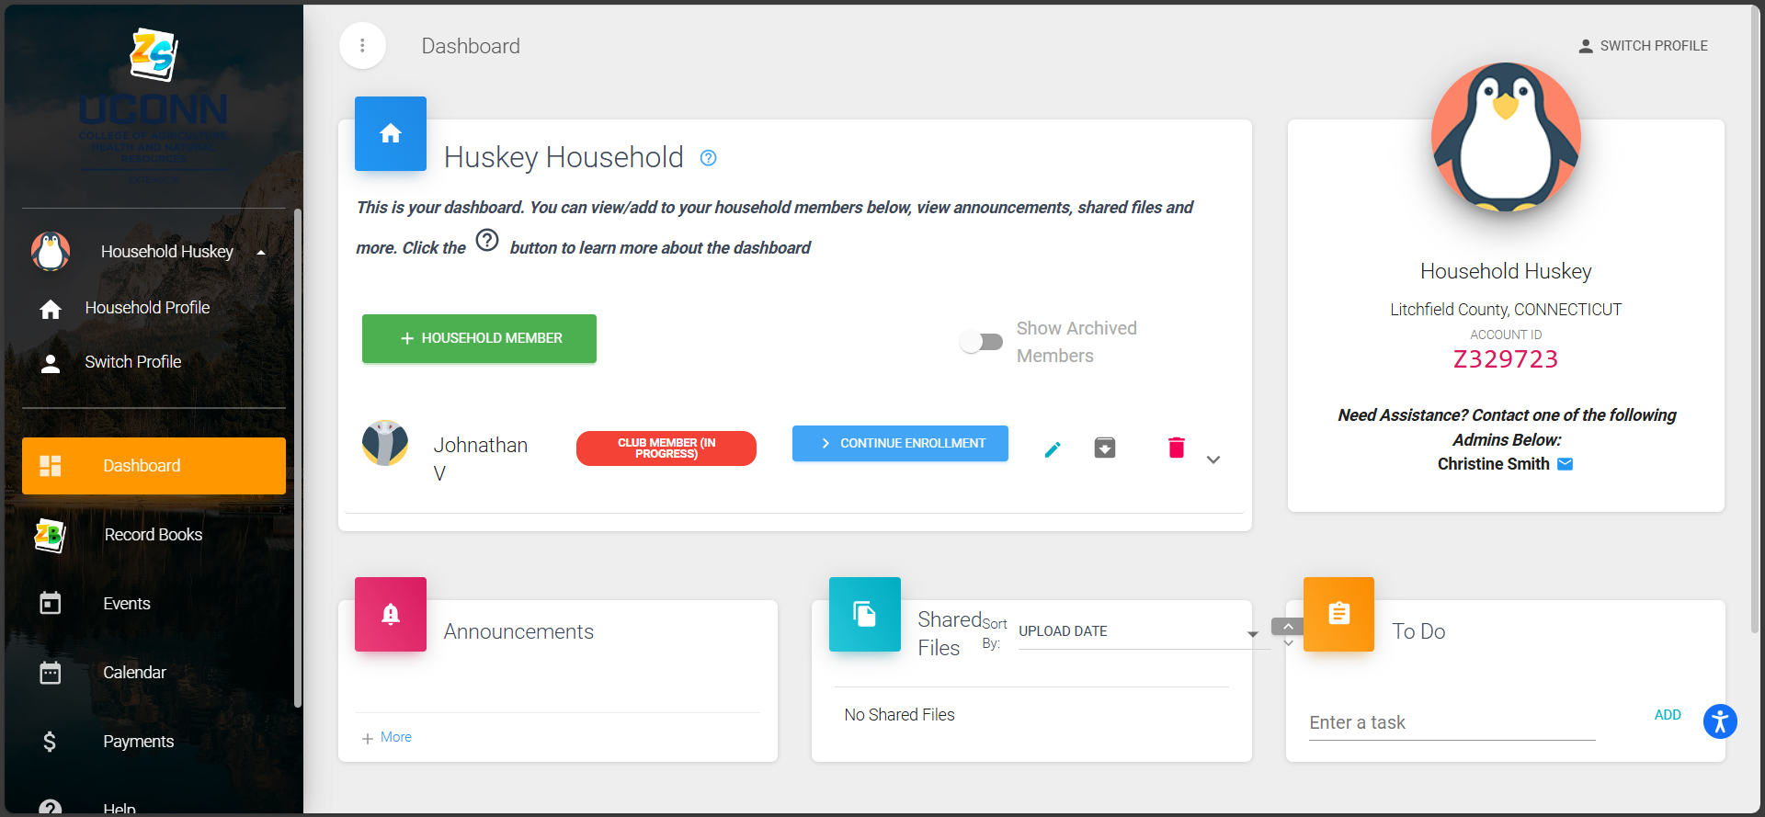
Z-Suite Household Members
Select “+ Household Member”
New Household members will appear below (see Jonathan IV profile)

Slide 4
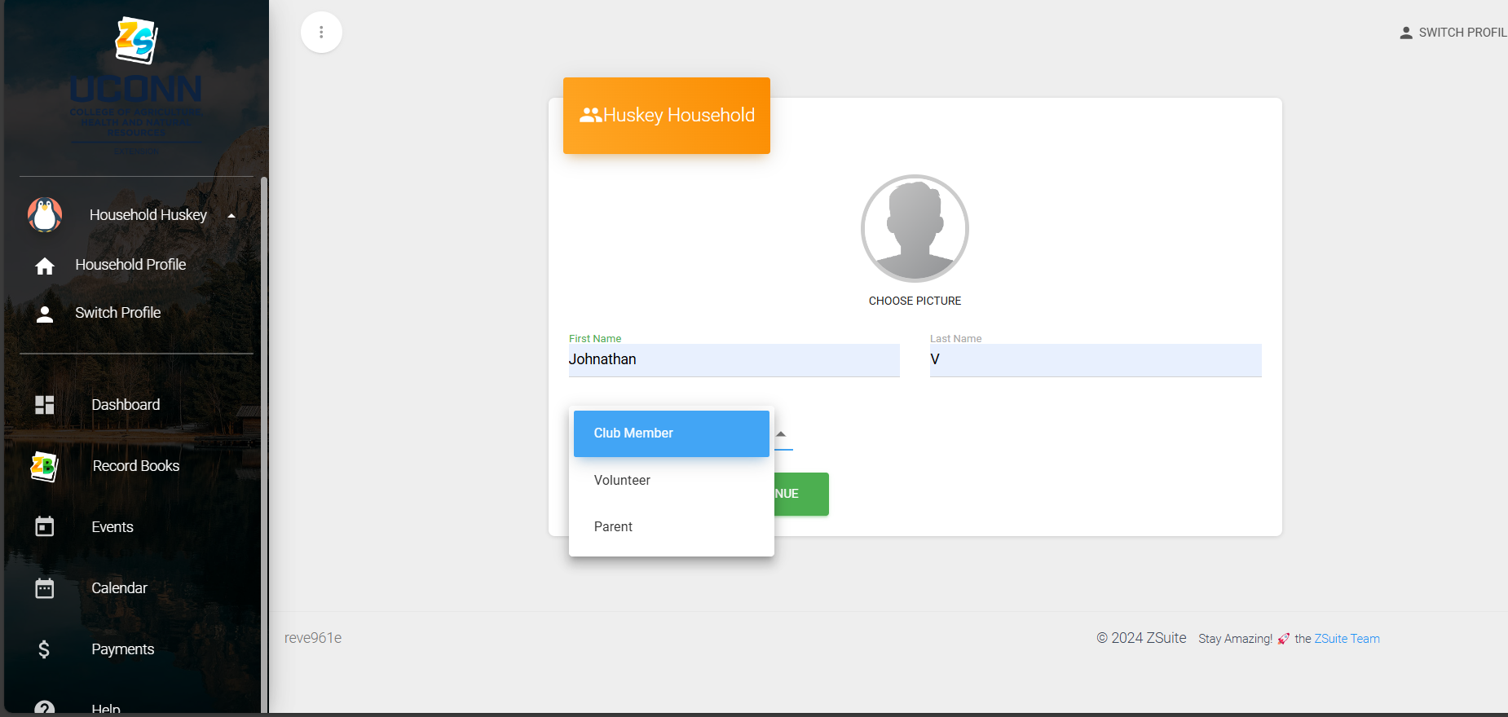
Household Enrollment
Enter Household member first and last name and type of membership

Slide 5
Z-Suite Household Members Cont.
Select “Continue Enrollment”
Note that it says “Club Member (In Progress)” once steps have been completed this will change

Slide 6
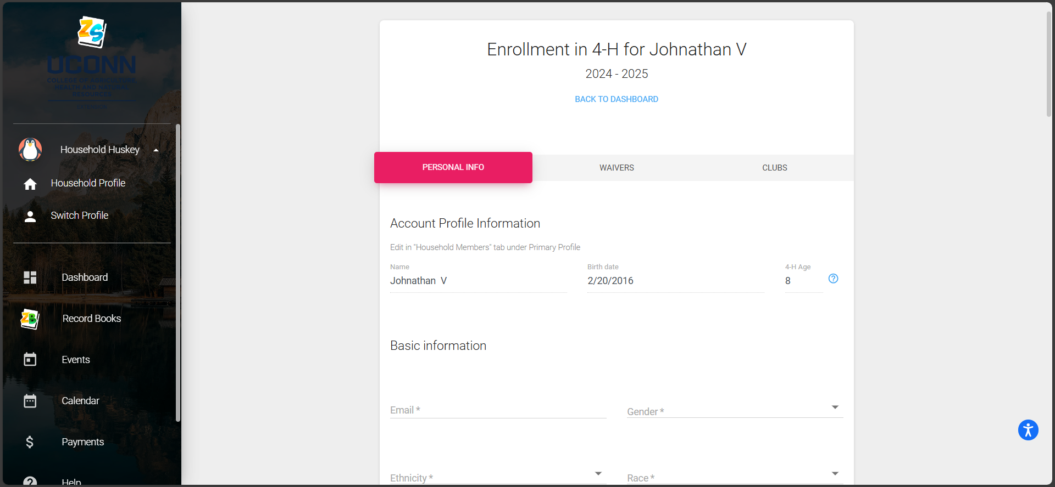
Member Enrollment
Enter Personal Information for the profile

Slide 7
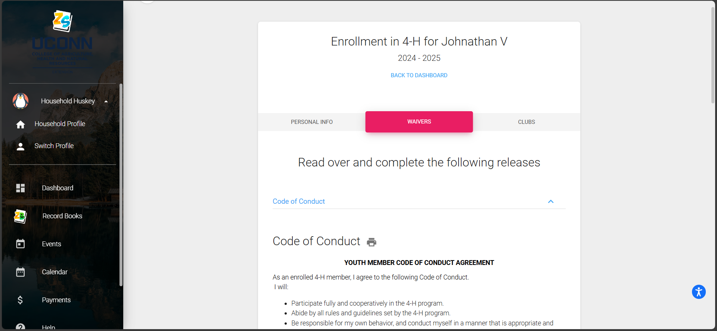
Annual Forms
Complete the five waivers attached: Code of Conduct, Consent and Waiver of Liability, Publicity Release, Health Waiver and UConn 4-H Parent Code of Conduct

Slide 8
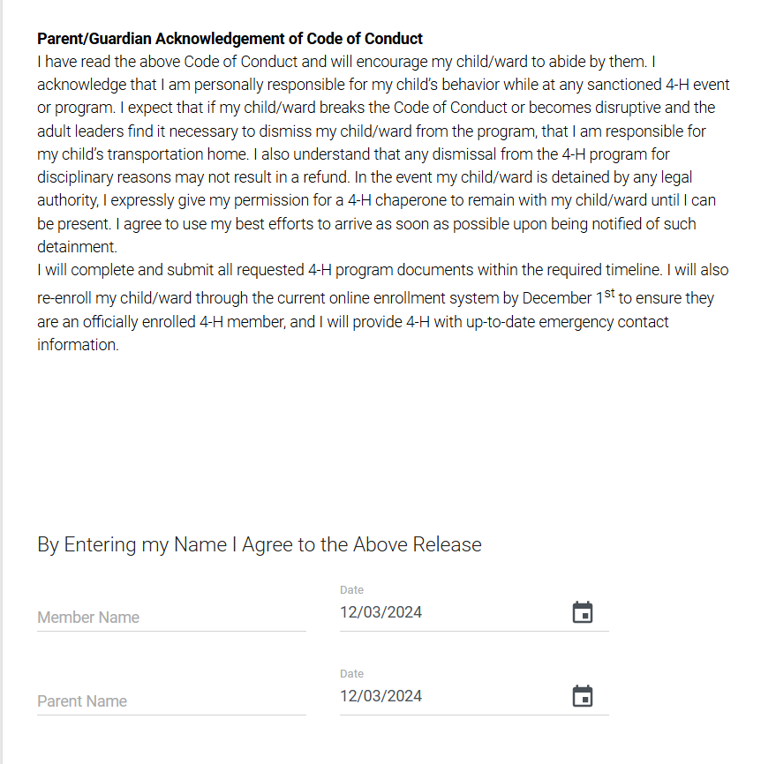
Youth Code of Conduct

Slide 9
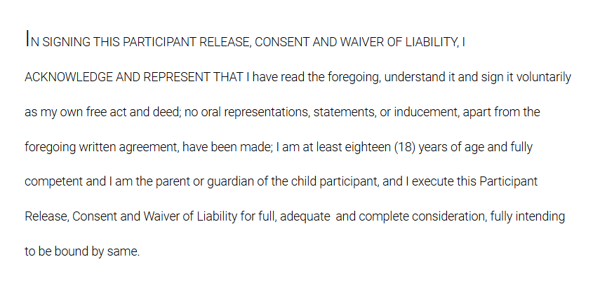
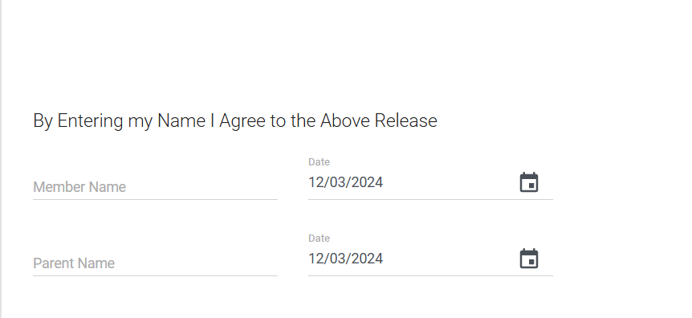
Consent and Waiver of Liability

Slide 10
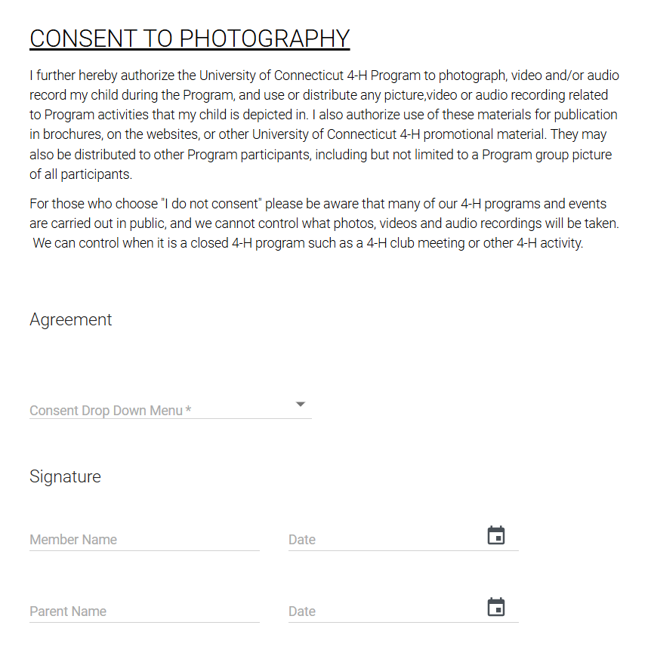
Publicity Release

Slide 11
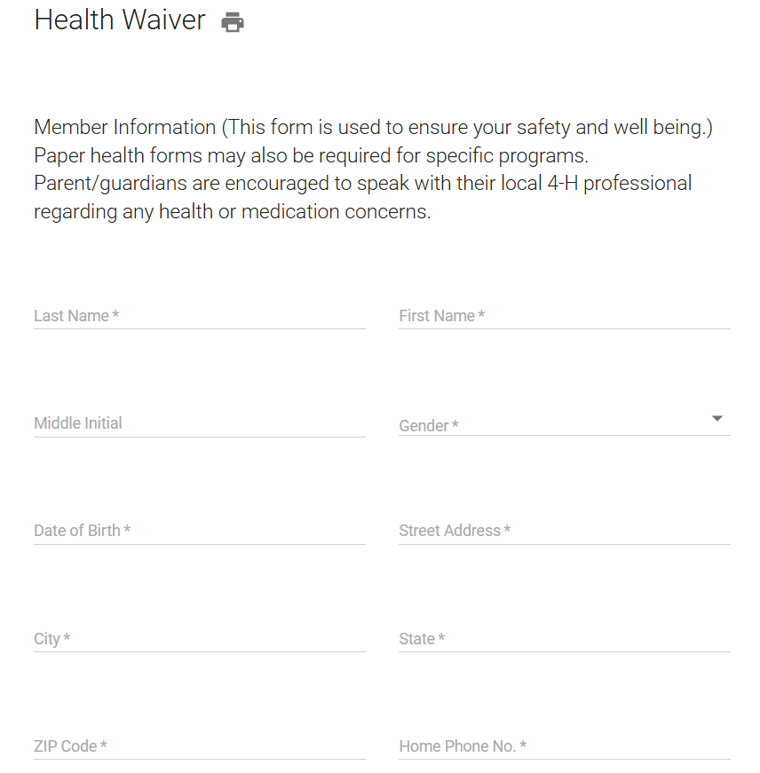
Health Wavier
Complete the following sections:
Member Information
Notify in Case of Emergency
Allergies
Personal Medical History
Parent/Guardian Authorizations
Consent for Medication Administration
Doctor Authorization Upload if Youth Under 13

Slide 12
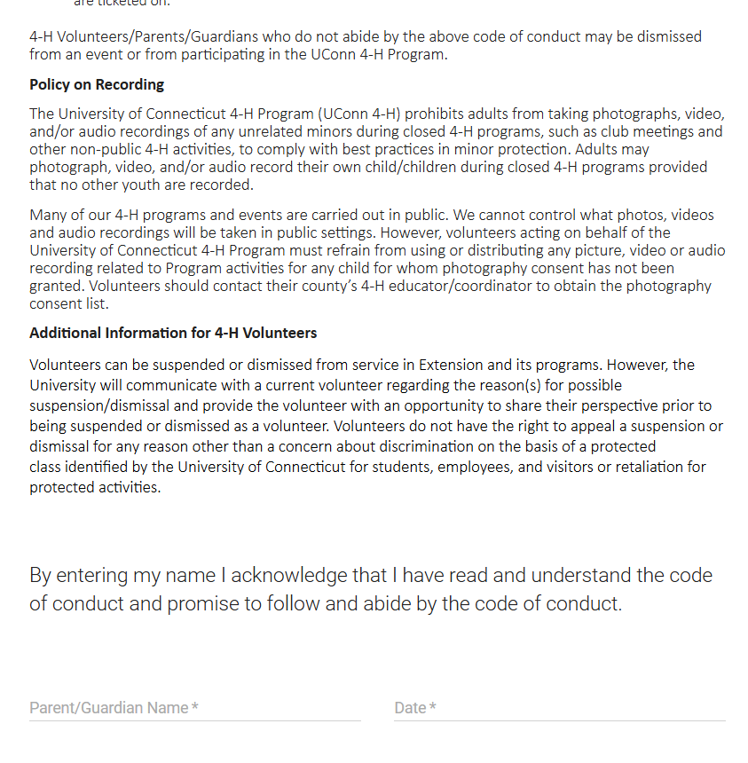
Parent Code of Conduct

