Slide 1
Z-Suite Homepage
Begin by searching, https://4h.zsuite.org/
Enter your email and password

Slide 2
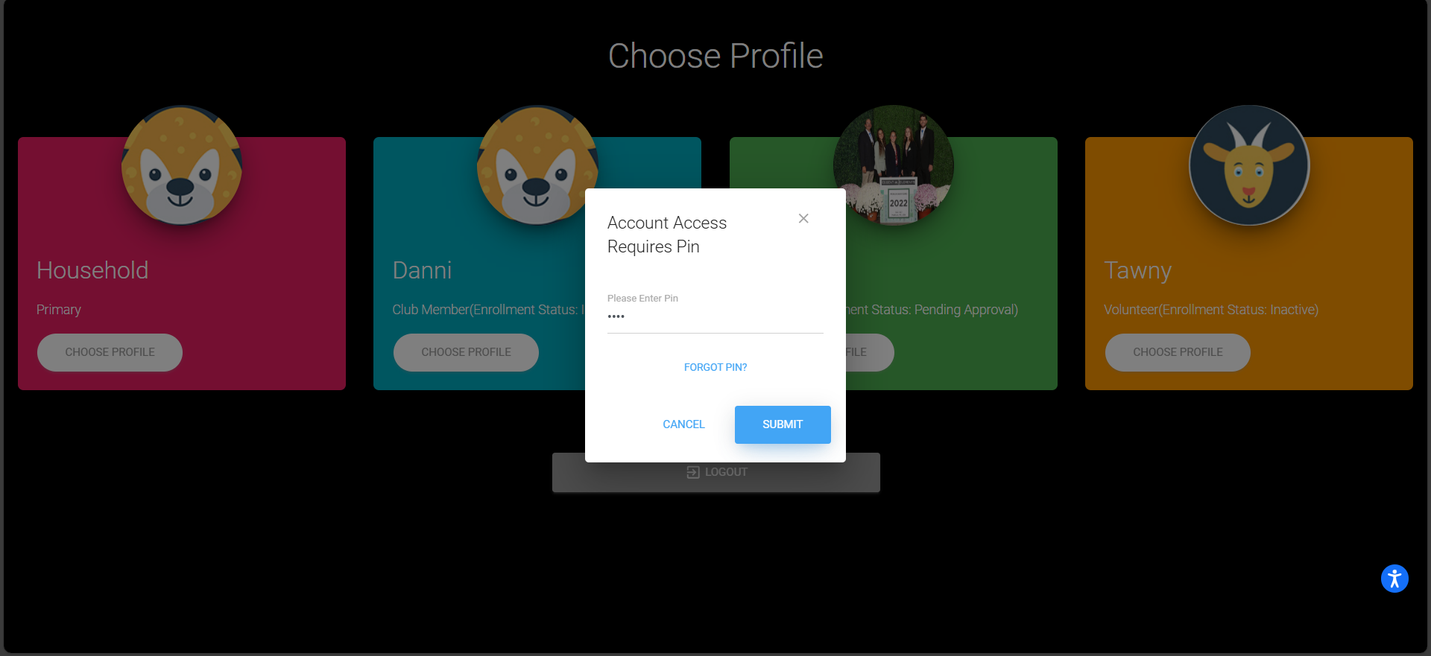
Z-Suite Pin Page
Enter your profile and the profile pin (If you forget your pin contact your 4-H educator)

Slide 3
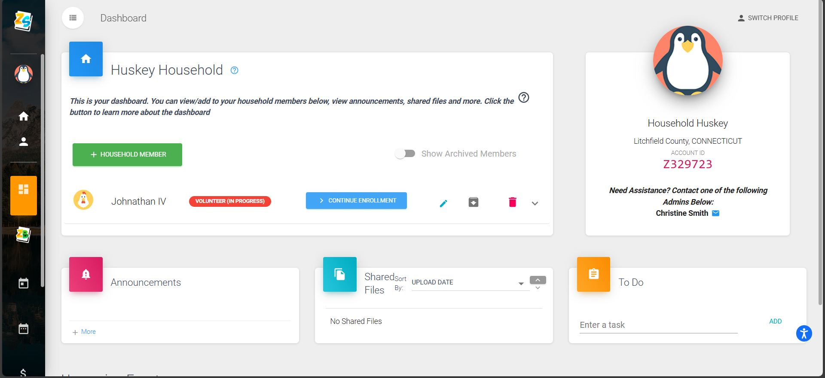
Z-Suite Member Enrollment
Go to “Dashboard” Select “Enroll Member Now”
The status of volunteers or members should be "INACTIVE"

Slide 4
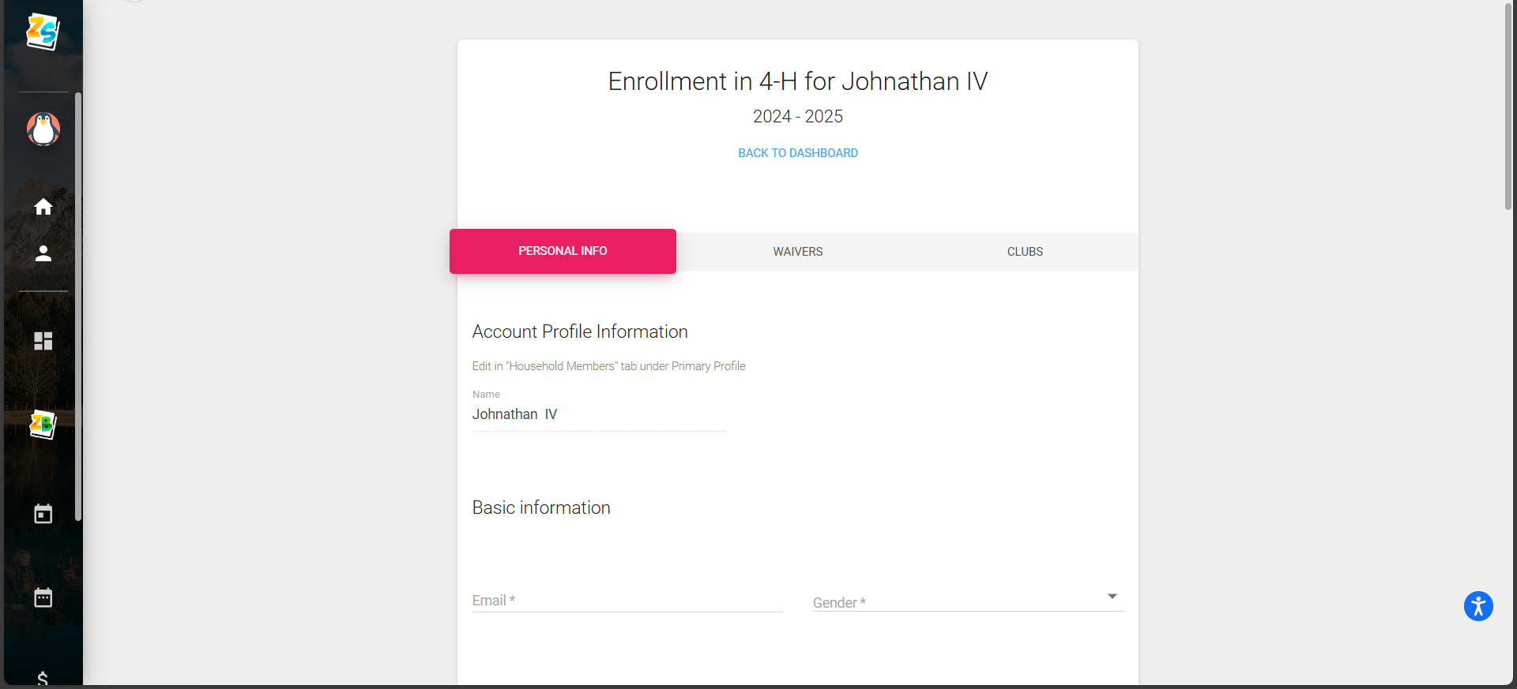
Z-Suite Personal Information
Update Personal Information for the profile

Slide 5
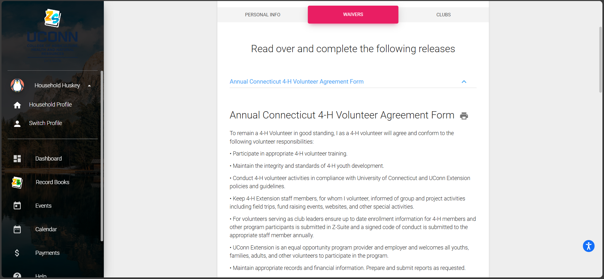
Annual Waivers
Update and complete the two waivers attached: Annual Connecticut 4-H Volunteer Agreement Form, UConn 4-H Volunteer Code of Conduct

Slide 6
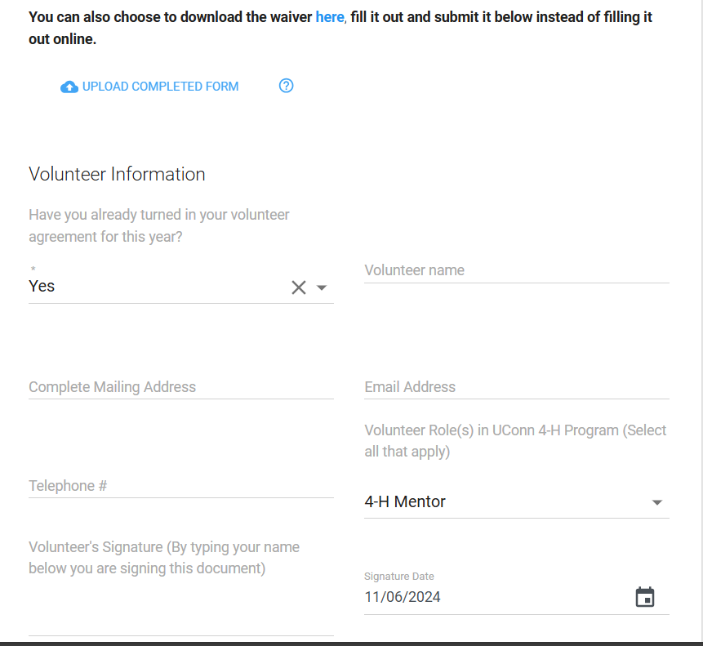
Annual Connecticut 4-H Volunteer Agreement Form
Complete the following fields: Name, Email, Mailing, Telephone, Role(s), signature and date

Slide 7
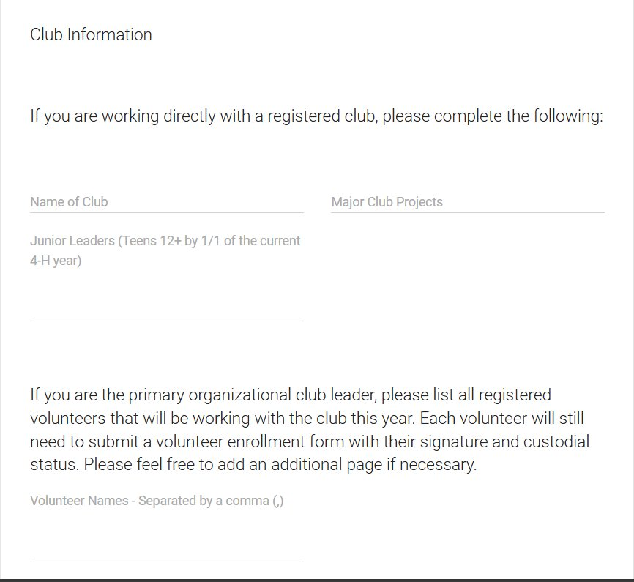
Annual Connecticut 4-H Volunteer Agreement Form Cont.
Complete the following fields: Club name, projects, Junior leaders and additional volunteers*
*Only if primary club leader

Slide 8
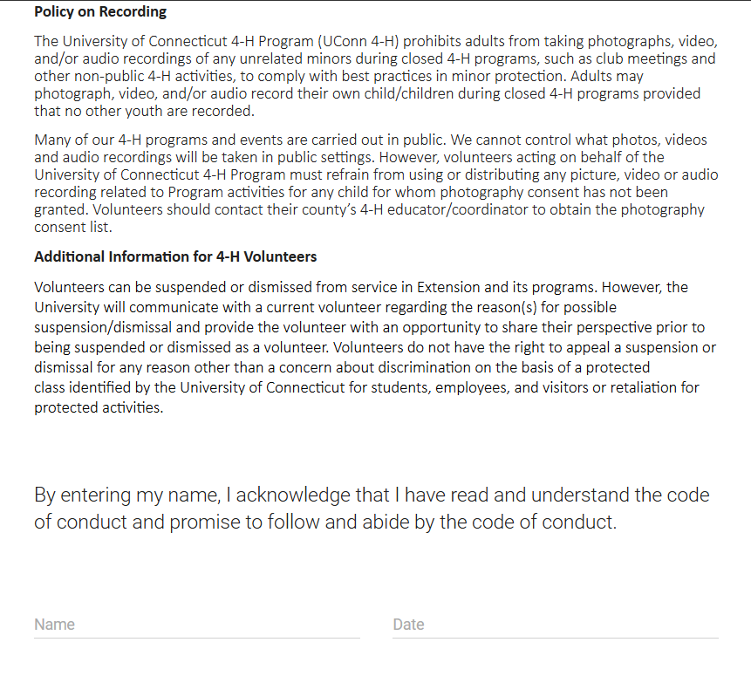
UConn 4-H Volunteer Code of Conduct

Slide 9
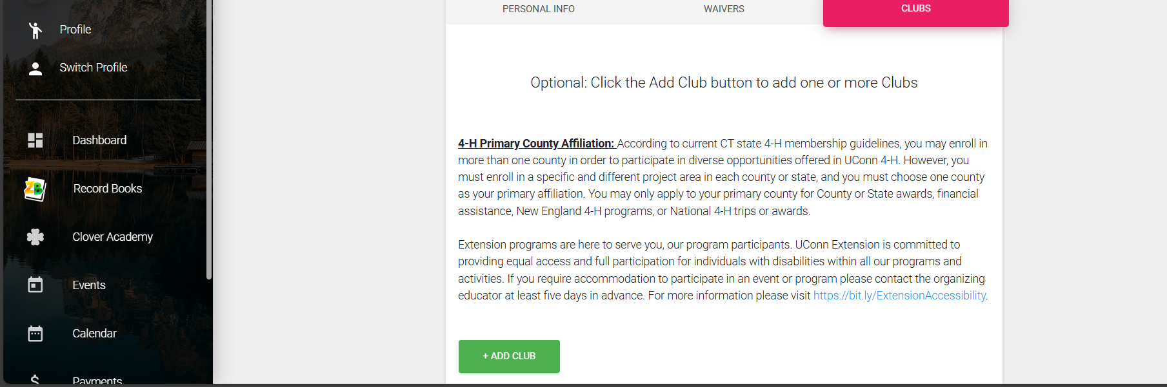
Club Information
Add or update your club and project groups that you work with.

Slide 10
Pending Approval
Once your enrollment is complete the “INACTIVE” will change to “Pending Approval”

Slide 11
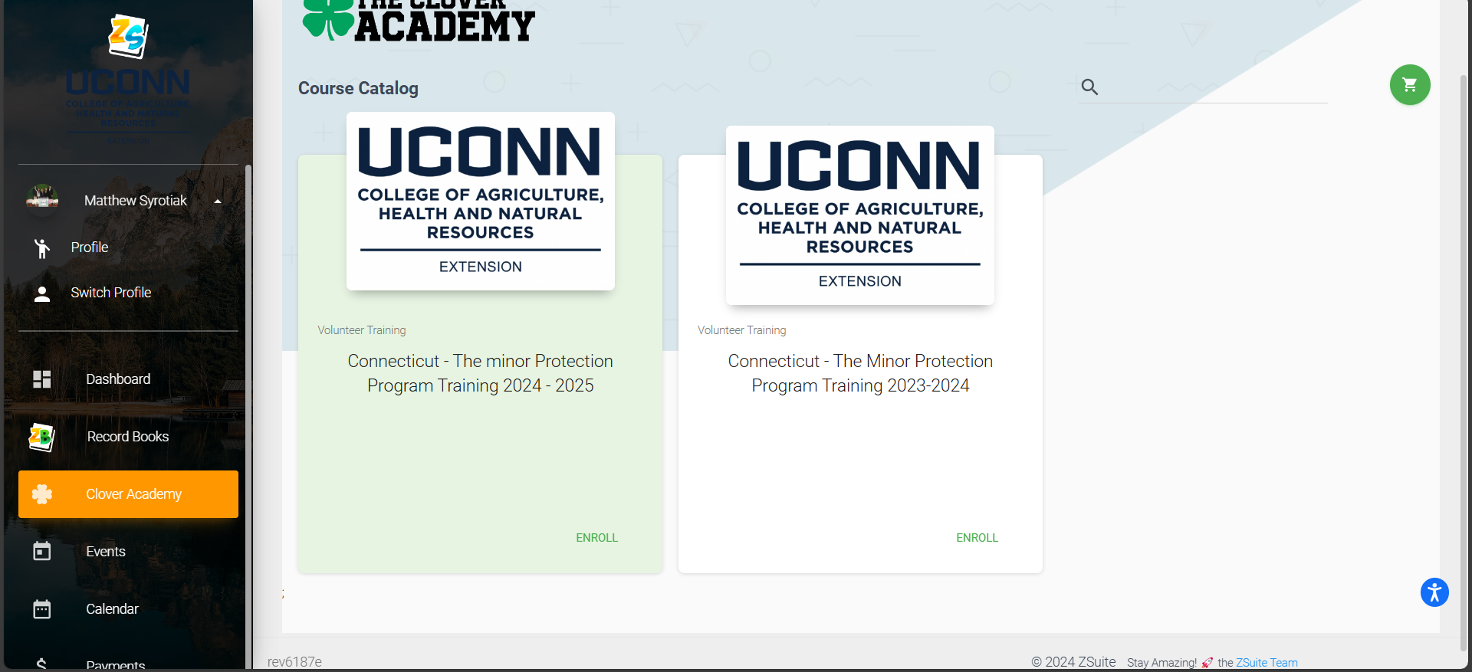
Minor Protection Training
Select the "Clover Academy" tab, Enroll in the Minor Protection Training for the current year and complete all modules. Note you must be in your individual profile NOT household.

