Slide 1
Z-Suite Homepage
Begin by searching, https://4h.zsuite.org/
Enter your email and password

Slide 2
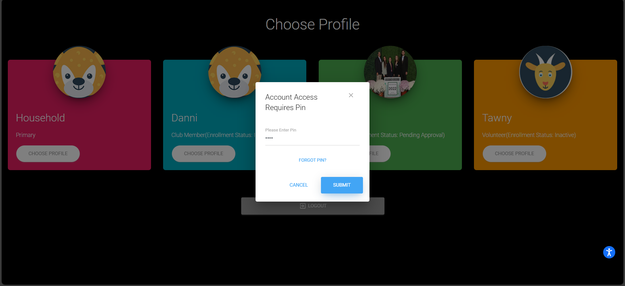
Z-Suite Pin Page
Enter your profile and the profile pin

Slide 3
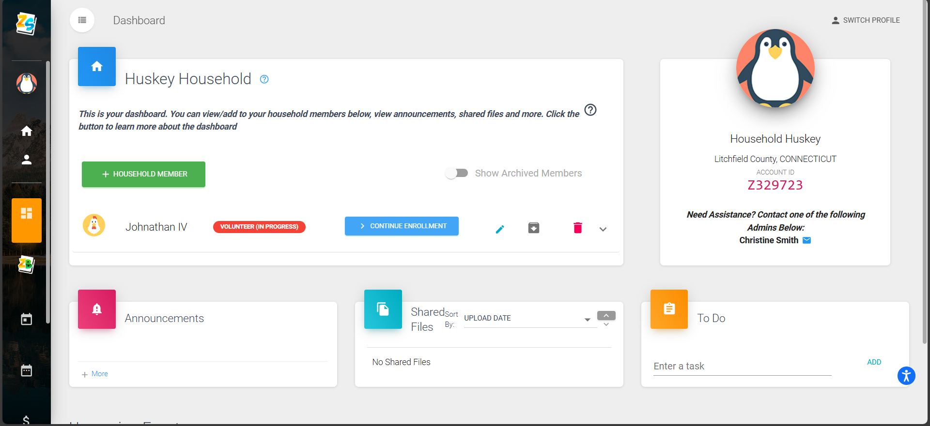
Z-Suite Member Enrollment
Go to “Dashboard” Select “Enroll Member Now”
The status of volunteers or members should be "INACTIVE"

Slide 4
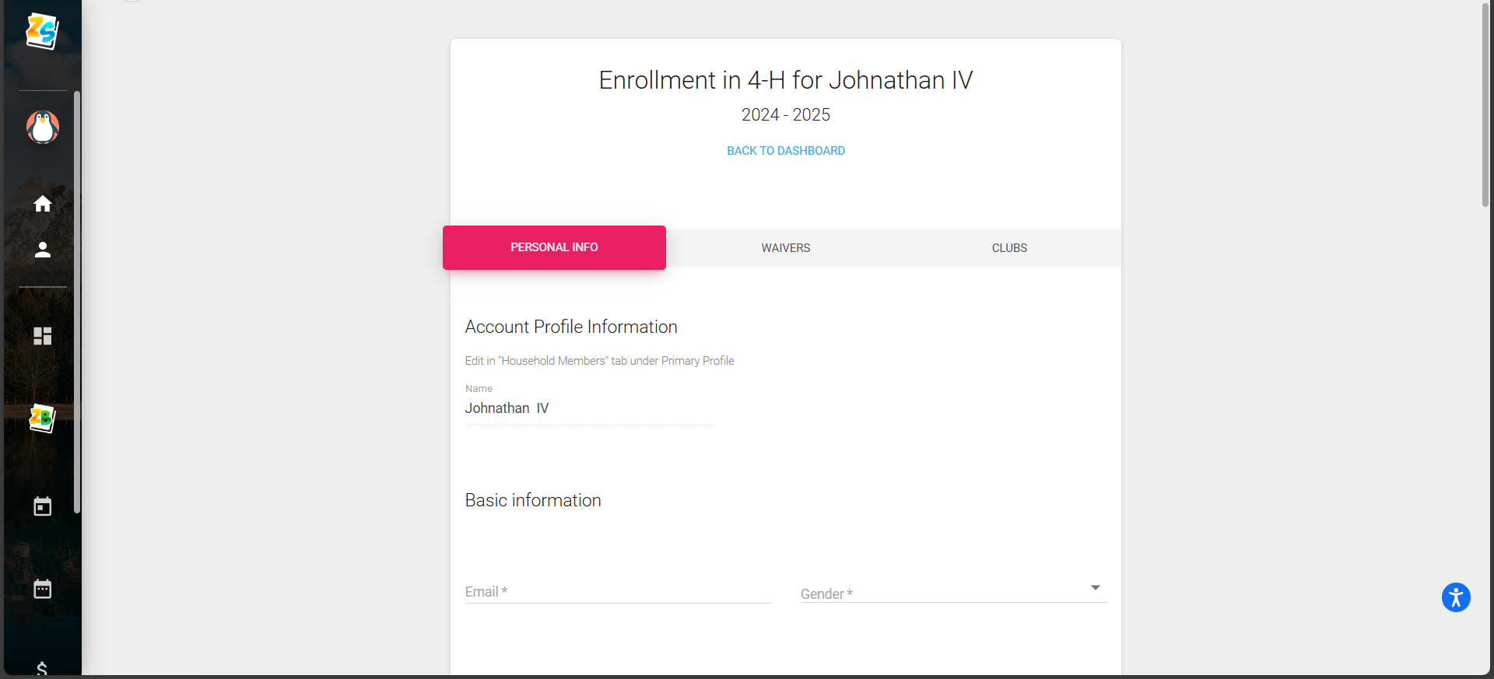
Z-Suite Personal Information
Update Personal Information for the profile

Slide 5
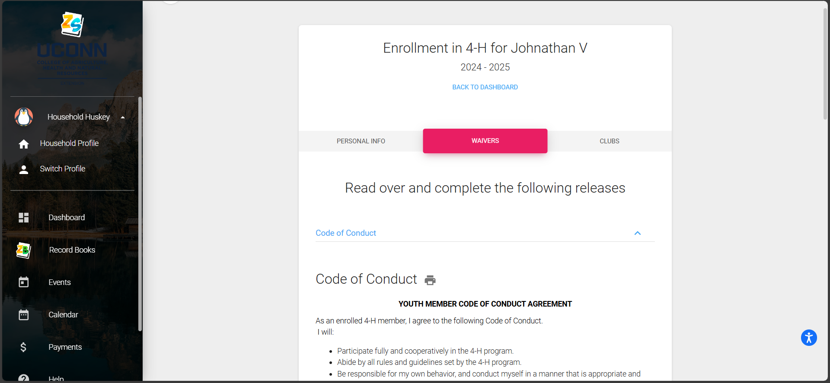
Annual Waivers
Update the five waivers attached: Code of Conduct, Consent and Waiver of Liability, Publicity Release, Health Waiver and UConn 4-H Parent Code of Conduct

Slide 6
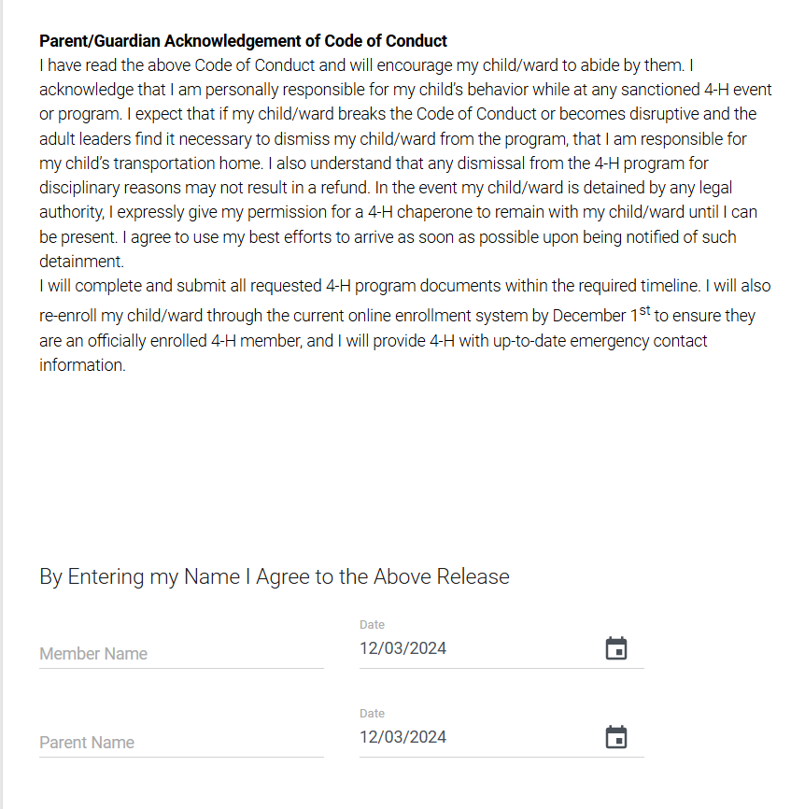
Youth Code of Conduct

Slide 7
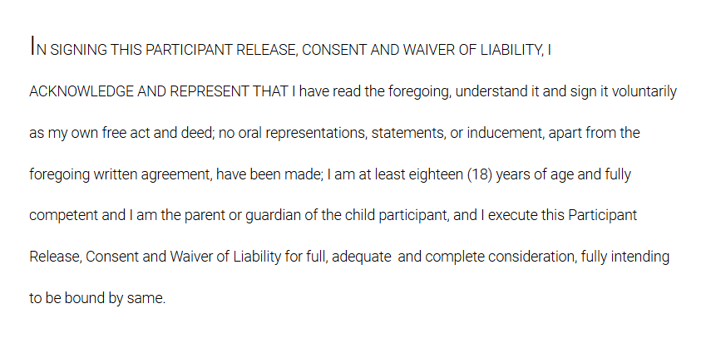
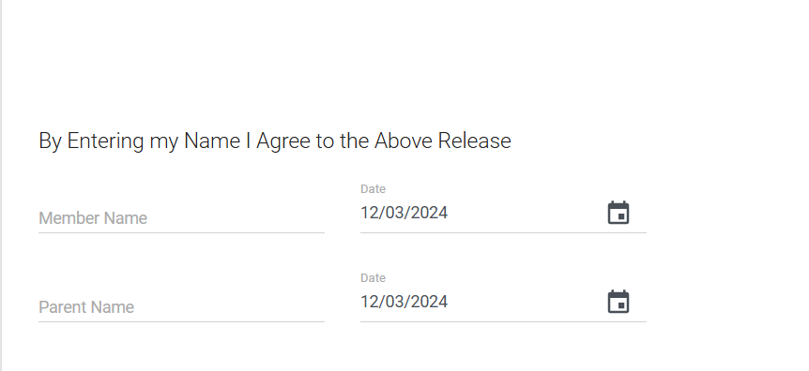
Consent and Waiver of Liability

Slide 8
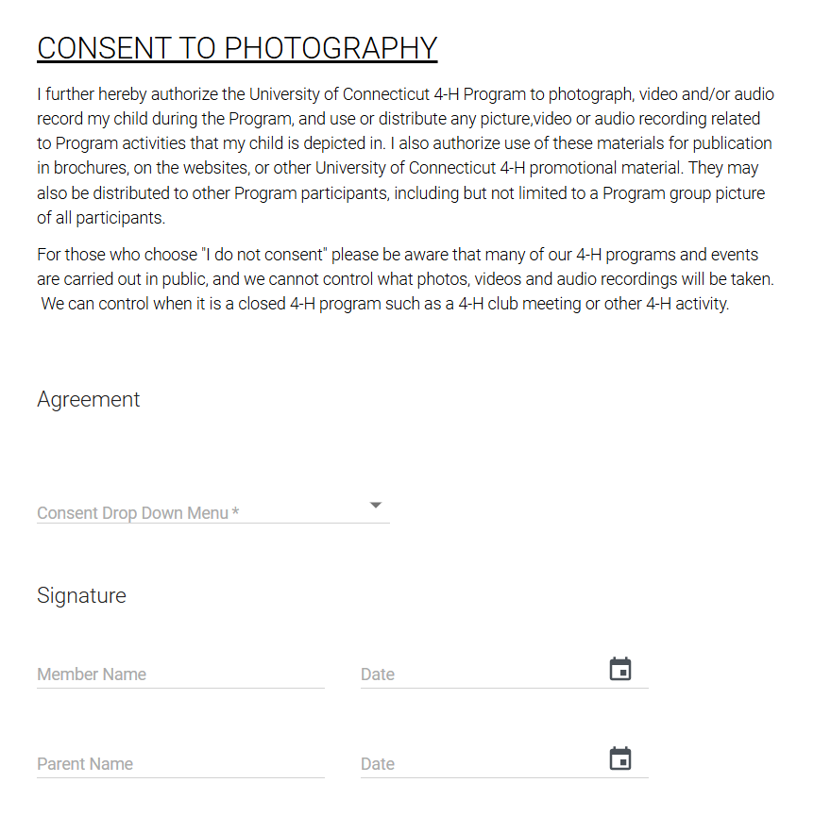
Publicity Release

Slide 9
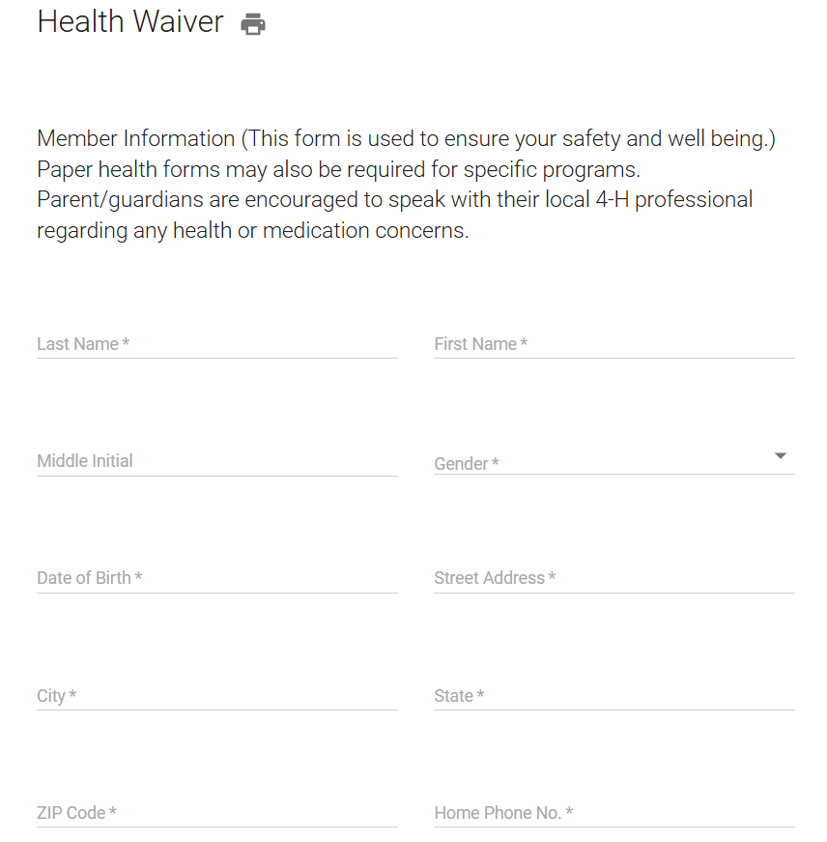
Health Wavier
Complete the following sections:
Member Information
Notify in Case of Emergency
Allergies
Personal Medical History
Parent/Guardian Authorizations
Consent for Medication Administration
Doctor Authorization Upload if Youth Under 13

Slide 10
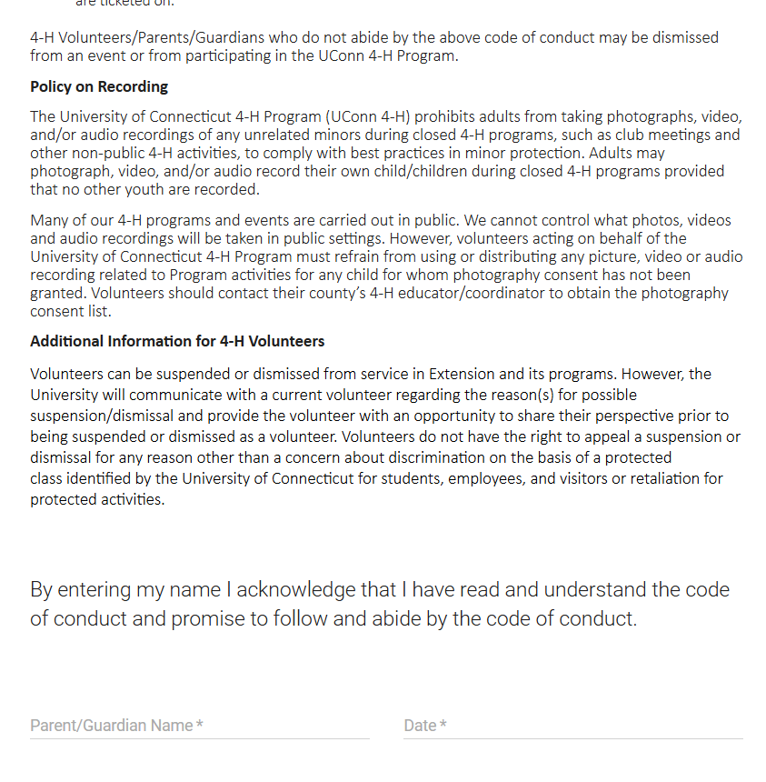
Parent Code of Conduct

Slide 11
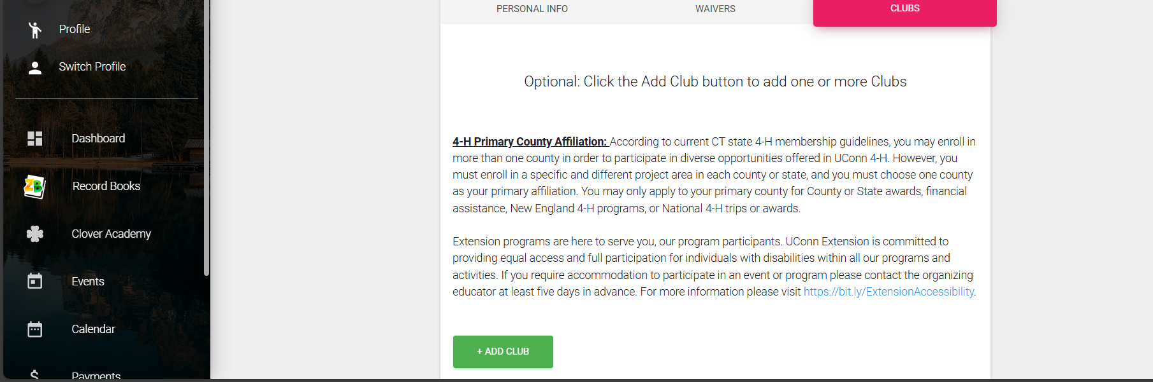
Club Information
Add or update your club and project groups that you work with.

Slide 12
Pending Approval
Once your enrollment is complete the “INACTIVE” will change to “Pending Approval”

