Slide 1
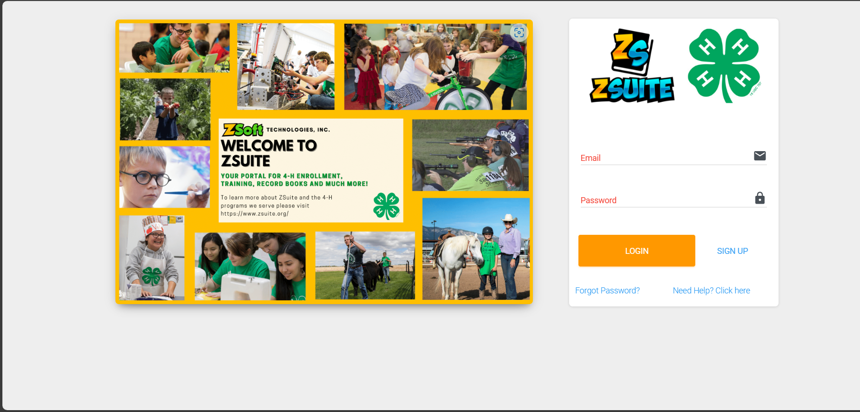
Z-Suite Homepage
Begin by searching, https://4h.zsuite.org/
Enter your email and password

Slide 2
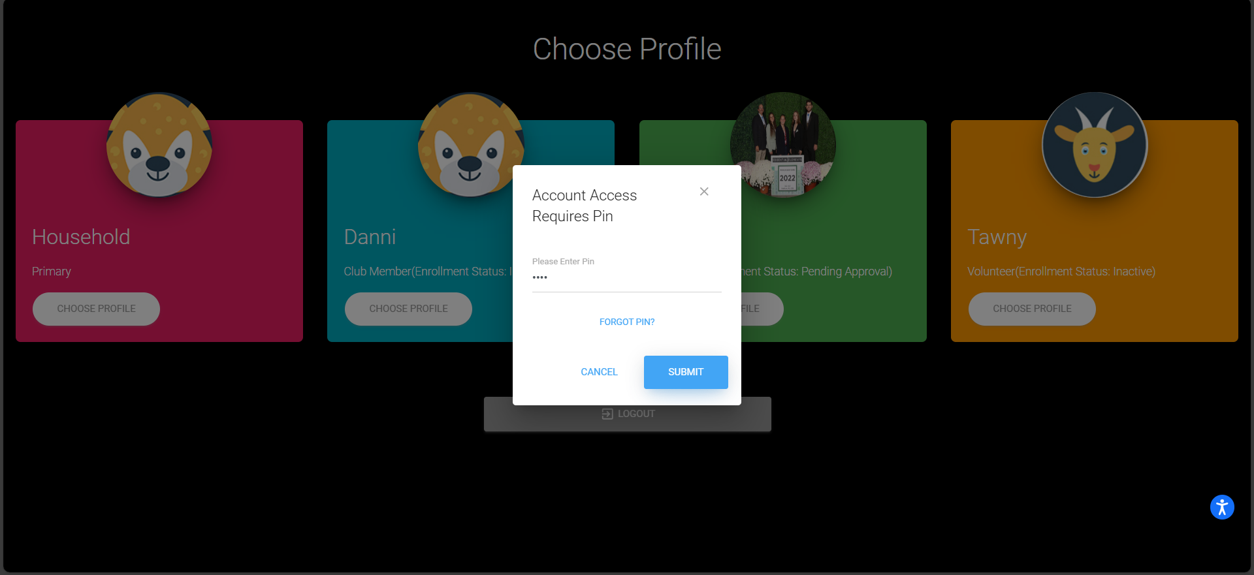
Z-Suite Pin Page
Enter your profile and the profile pin (If you forget your pin contact your 4-H educator)

Slide 3
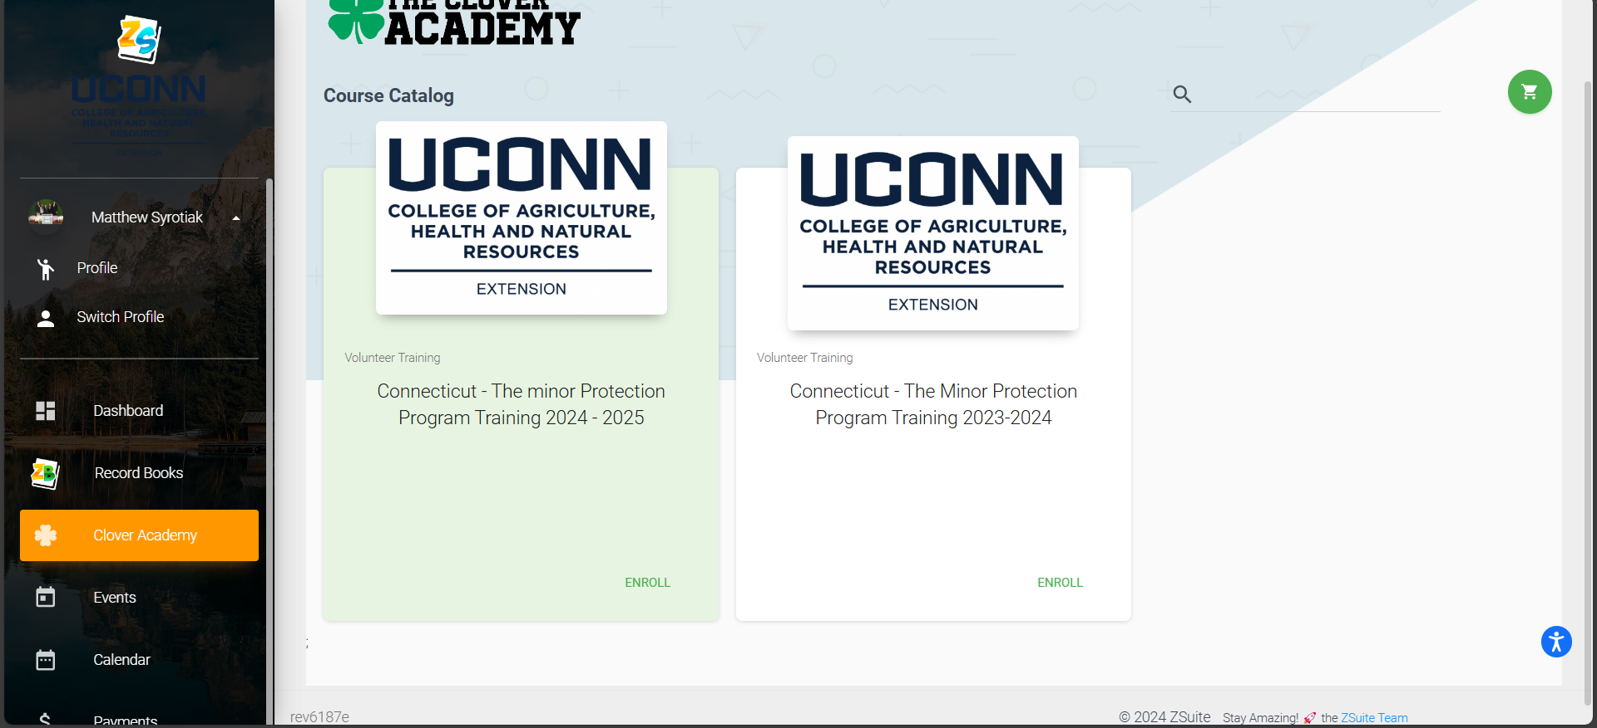
Minor Protection Training
Select the "Clover Academy" tab, Enroll in the Minor Protection Training for the current year and complete all modules. Note you must be in your individual profile NOT household.

